Slide 1
HARVESTIFY: EMPOWERING CROP YIELDS THROUGH INTELLIGENT NUTRIENT OPTIMIZATION
Under the Guidance
Presented by :
Dr.T.Kumaragurubaran., M.Tech., Ph.D
Abdul Hazeer (2116 210701007)
Associate Professor
Haarthy S L (2116 210701065)

Slide 2
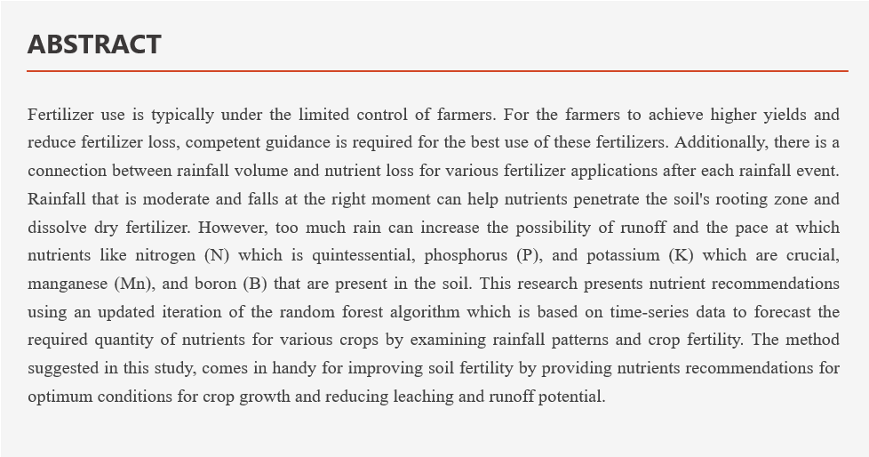

Slide 3
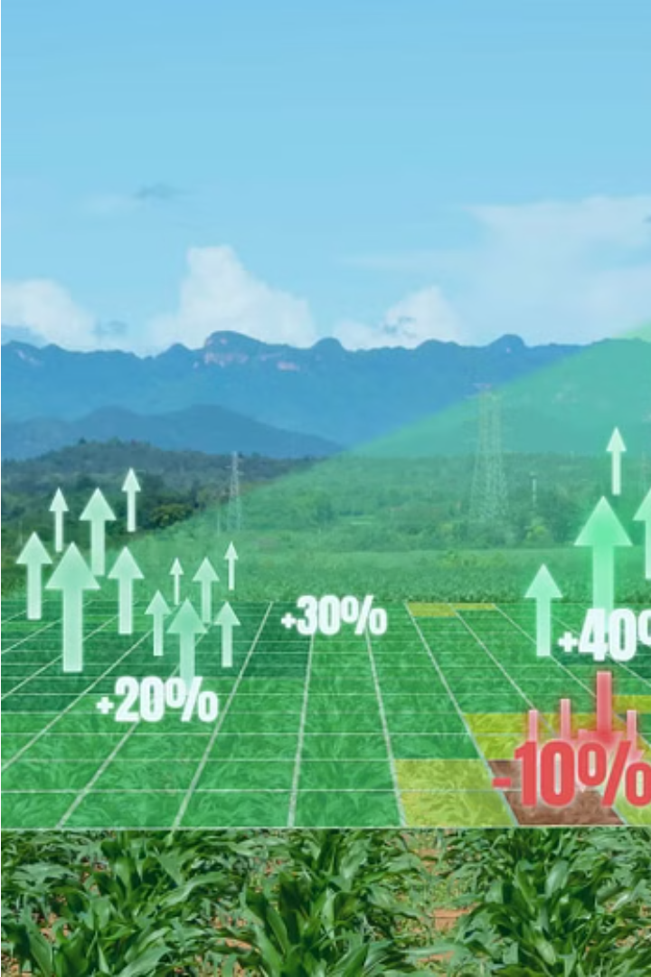
PROBLEM STATEMENT
The challenge entails inconsistent and improper fertilizer use significantly impacts crop yields, soil health, and farmers' economic returns. This project aims to develop a machine learning-based system to provide precise fertilization recommendations, optimizing nutrient use and timing. Utilizing a random forest algorithm with k-fold cross-validation, the model analyzes historical crop fertility and rainfall data. By inputting crop type and location, farmers receive customized nutrient and application timing advice. The web platform, built with Flask Python, ensures accessibility for farmers, promoting sustainable practices and enhancing agricultural productivity, thus supporting national economic growth in India's agriculture sector.

Slide 4

Literature Review
Crop Nutrient Optimization
Precision Farming Technologies
Research has shown that optimizing the application of essential nutrients like nitrogen, phosphorus, and potassium can significantly increase crop yields and quality.
Emerging technologies like sensor networks, drones, and data analytics can provide real-time insights into soil conditions and plant health to enable more precise nutrient management.
Machine Learning Applications
Advanced machine learning models can analyze complex datasets to identify optimal nutrient application strategies tailored to specific soil types, climate conditions, and crop varieties.

Slide 5
Literature Review
Ref No. | Year | Title | Author’s Name | Journal | Description
1. | 2018 | Prediction of Crop Fertilizer Consumption | Krutika Hampannavar, Vijay Bhajantri Shashikumar G. Totad | IEEE, DOI:10.1109/ICCUBEA.2018.8697827 | Prediction of fertilizer consumption can prevent the toxicity and deficiency in plants to certain extent and this can help farmers to get proper yield without much wastage.
2. | 2018 | Fuzzy decision support system for improving the crop productivity and efficient use of fertilizers | G. Prabakaran,D. Vaithiyanathan, Madhavi Ganesan | Computers and Electronics in Agriculture ,ISSN : 0168-1699 (Elsevier) | This paper explores the process of using fuzzy logic systems to reduce fertilizer consumption and improve crop productivity.
3. | 2018 | Data Mining Techniques for Crop Yield Prediction | Shital Bhojani Nirav Bhatt | Computers and Electronics in Agriculture, ISSN: 0168-1699 (Elsevier) | It's a difﬁcult task to predict crop yield due to stochastic rain fall pattern and also variation in temperature. So we can apply different data mining techniques for crop yield predication and can produce an efﬁcient algorithm for crop classiﬁcation for better.

Slide 6
Literature Review
Ref No. | Year | Title | Author’s Name | Journal | Description
4. | 2019 | Estimation of NPK requirements for rice production in diverse Chinese environments under optimal fertilization rates | Yulong Yin, Hao Ying Huifang Zheng ,Qingsong Zhang ,Yanfang Xue, Zhenling Cui | Agricultural and Forest Meteorology, ISSN : 0168-1923 (Elsevier) | Objectives of this study were to evaluate the relationship between nutrient requirements and climates or soil chemical properties.
5. | 2020 | Rainfall intensification increases nitrate leaching from tilled but not no-till cropping systems in the U.S. Midwest | Laura J.T. Hess Eve-Lyn S. Hinckley G. Philip Robertson Pamela A. Matson | Agriculture, Ecosystems & Environment, ISSN : 0167-8809 (Elsevier) | Rainfall intensification may exacerbate leaching losses of reactive N from cropping systems, and that no-till management may buffer against these losses.
6. | 2020 | Crop Yield Prediction Based on Indian Agriculture using Machine Learning | Potnuru Sai Nishant Pinapa Sai Venkat Bollu Lakshmi Avinash B. Jabber | 2020 International Conference for Emerging Technology (INCET) | This paper predicts the yield of almost all kinds of crops in India. This script makes novel by usage of simple parameters like state, district, season, area and the user can predict the yield of the crop in which year he or she wants to.

Slide 7
Literature Review
Ref No. | Year | Title | Author’s Name | Journal | Description
7. | 2020 | Cropping systems in agriculture and their impact on soil health | TonyYang, Kadambot H.M. Siddique, Kui Liu | Global Ecology and Conservation, ISSN: 2351-9894 (Elsevier) | Significant achievements, including refine content of soil health and the development of new evaluation standards for ‘soil health and quality’.
8. | 2020 | Would fertilization history render the soil microbial communities and their activities more resistant to rainfall fluctuations? | János Kátai Ágnes Oláh Zsuposné Magdolna Tállai Tarek Alshaal | Ecotoxicology and Environmental Safety, ISSN: 0147-6513 (Elsevier) | This paper aims to study the intrinsic changes in the composition of soil populations and their functions due to the interaction between long-term fertilization and rainfall fluctuations, seeing whether fertilization history would render the soil microbial communities and their activities more resistant to water stress or not.
9. | 2021 | A nutrient recommendation system for soil fertilization based on Evolutionary Computation. | Usman Ahmed Jerry Chun-Wei Lin Gautam Srivastava Youcef Djenouri | Computers and Electronics in Agriculture, ISSN: 0168-1699 (Elsevier)) | This paper develops a model that enables efficient exploration of correct usage of nutrients (such as N, P and K) for developing a knowledge-based system for the ICT (Information and Communication Technology) environment.

Slide 8
Literature Review
Ref No. | Year | Title | Author’s Name | Journal | Description
10. | 2021 | Controlled traffic farming effects on productivity of grain sorghum, rainfall and fertiliser nitrogen use efficiency | A.Hussein Diogenes L. Antille Shreevatsa Kodur GuangnanChen Jeff N.Tullberg | Journal of Agriculture and Food Research | Enhanced efficiency fertilizers cannot compensate for other stresses caused by compaction.
11. | 2021 | Optimized fertilizer recommendation method for nitrate residue control in a wheat–maize double cropping system in dryland farming | Zujiao Shi, Donghua Liu, Miao Liu, Muhammad Bilal Hafeez, Pengfei Wen, Xiaoli Wang, Rui Wang, Xudong Zhang, Jun Li | Field Crops Research ISSN: 0378-4290 (Elsevier) | To optimize the fertilizer recommendation method and reduce nitrate residue levels, this paper establishes the relationships between crop yield, nitrogen requirement, and nitrate residue level under combined N and P fertilizer application.
12. | 2021 | Analysis of agricultural crop yield prediction using statistical techniques of machine learning | Janmejay Pant, R.P. Pant, Manoj Kumar Singh, Devesh Pratap Singh, Himanshu Pant | Materials Today: Proceedings, ISSN: 2214-7853 (Elsevier) | This paper suggests the use of Machine Learning techniques to create a trained model for detecting patterns in data, which we then used to predict crop yields. The application of machine learning to the prediction of four of India's most cultivated yields is considered in this study. Maize, potatoes, rice (paddy), and wheat are among these crops.

Slide 9
Literature Review
Ref No. | Year | Title | Author’s Name | Journal | Description
13. | 2021 | Prediction of the production of crops with respect to rainfall. | Benny Antony | Environmental Research, ISSN: 0013-9351 (Elsevier) | This paper predicts the production of crops as a function of rainfall. This is implemented by generating a rough overview of how the production is based on rainfall and how much can a specific crop production for the amount of rainfall it receives. The proposed method of evaluation is better than other existing methods of evaluation as it evaluates all the regression techniques.
14. | 2021 | Factors affecting agriculture and estimation of crop yield using supervised learning algorithms | Akash Manish Lad, K. Mani Bharathi, B. Akash Saravanan, R. Karthik | Materials Today: Proceedings, ISSN: 2214-7853 (Elsevier) | Comprehensive method developed to estimate crop sustainability using supervised algorithms that increase crop yields, reduce manual labor, time spent on various agricultural activities and plant recommendations based on certain soil parameters.
15. | 2021 | Precision agriculture using IoT data analytics and machine learning | Raves Akhtar, Shabbir Ahmad Sofi | Journal of King Saud University - Computer and Information Sciences,ISSN: 1319-1578(Elsevier) | This paper proposes an apple disease prediction model in apple orchards in Kashmir Valley using data analysis and machine learning in an IoT system. The paper discusses the challenges faced when integrating these technologies into traditional agricultural approaches.

Slide 10
PROPOSED SYSTEM
The proposed system aims to develop a web-based application that provides precise fertilizer recommendations to farmers, optimizing nutrient use and timing to enhance crop yields, soil health, and economic returns. Utilizing the Random Forest algorithm with k-fold cross-validation, the system analyzes historical soil nutrients, crop needs, and weather data, integrating real-time weather data through a Weather API to ensure up-to-date recommendations. Key components include data preparation, involving handling historical data and key feature selection, and a machine learning model using Random Forest Regression for nutrient prediction, validated with metrics like MAE and MSE. The user interface allows farmers to input crop type, location, and weather conditions, while recommendation modules suggest optimal fertilization timing and NPK ratio estimation. The output module displays nutrient recommendations along with a 7-day rainfall forecast. Continuous user testing and feedback will refine the system, ensuring its practical utility and continuous improvement. This system supports sustainable agricultural practices and aims to enhance India's agricultural productivity.

Slide 11
METHODOLOGY
In this study, a predictive model for the nutrients required for crops was developed using Random Forest Regression, validated with the K-Fold Cross Validation technique to ensure acceptable accuracy. The model evaluates seven key features and requires user inputs such as location and cropping information. The location data is fed into a Weather API that provides specific characteristics like temperature, humidity, and rainfall. If there is a possibility of heavy rainfall, a precautionary message is displayed to the user; otherwise, the proposed nutrient recommendation algorithm is followed.

Slide 12
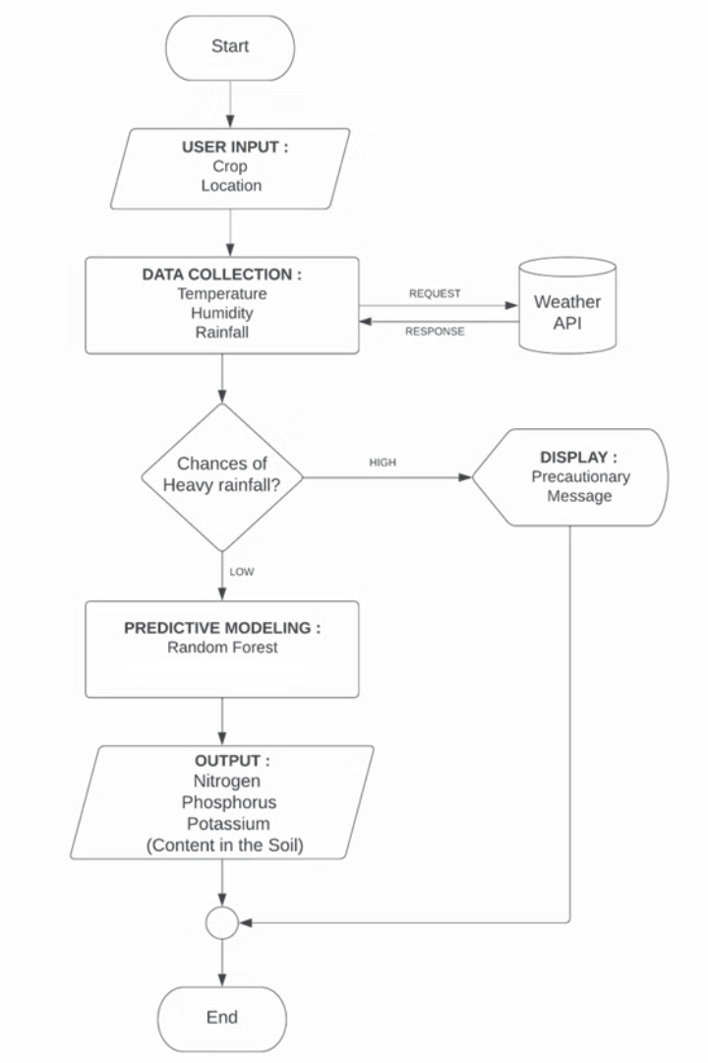
IMPLEMENTATION MODEL
Flow Chart:

Slide 13

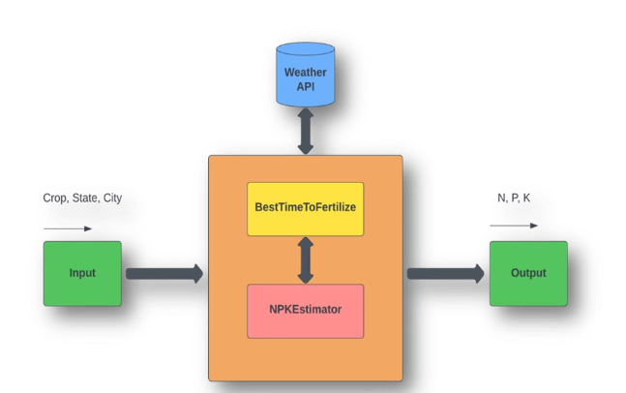
IMPLEMENTATION MODEL
Architecture Diagram:
System architecture is a conceptual model that defines the structure and behavior of a system, comprising its components and the relationships between them. It describes how these components work together to implement the overall system. The figure illustrates the system's architecture and the various components integrated into it.

Slide 14
IMPLEMENTATION MODEL
The description of each component from the block diagram and their major functionalities with respect to the harvest helper as a complete unit is described in the table below.

Slide 15
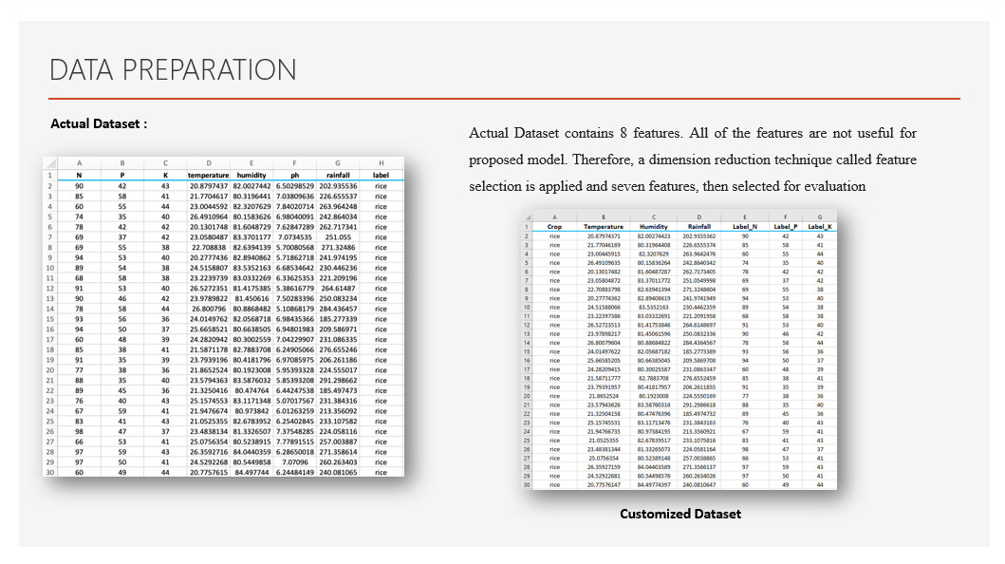

Slide 16




DATA PREPARATION
Data Collection
Gather historical crop yield data, soil nutrient levels, weather patterns, and other relevant agricultural metrics from various sources to build a comprehensive dataset.
Data Cleaning
Identify and address any missing values, outliers, or inconsistencies in the dataset to ensure data integrity and reliability.
Feature Engineering
Analyze the dataset and create new derived features that may provide additional insights, such as climate indices or soil composition ratios.
Train-Test Split
Partition the dataset into training and testing subsets to enable effective model development, evaluation, and validation.

Slide 17
Data Description
Input Features :
Output Features :
Crop : rice, cotton, etc.
Label_N : ratio of Nitrogen content in soil
Temperature : temperature in degree Celsius
Label_P : ratio of Phosphorous content in soil
Humidity : relative humidity in percentage
Label_K : ratio of Potassium content in soil
Rainfall : rainfall in mm

Slide 18
Implementation Algorithm

Slide 19
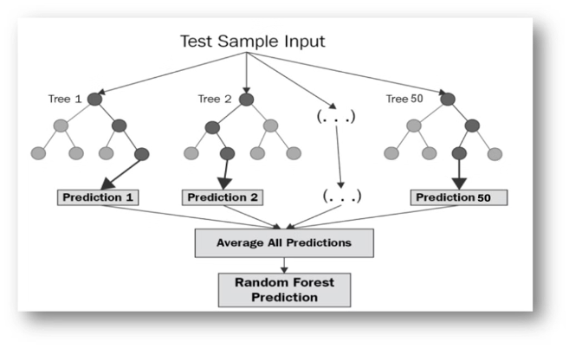
Implementation Algorithm
Random forest (RF) is an ensemble method comprising multiple decision trees with variable hyper-parameters, each trained on different subsets of data.
In our project, we will take crop and location as inputs to predict the values of nitrogen (N), phosphorus (P), and potassium (K).
We will start by dividing our dataset into training and test sets, using 80% of the data for training and the remaining 20% for testing.
Random Forest Method
We will then create three separate random forests, each consisting of 50 decision trees, to predict N, P, and K values. The output will be the mean prediction of all the trees in each forest.

Slide 20
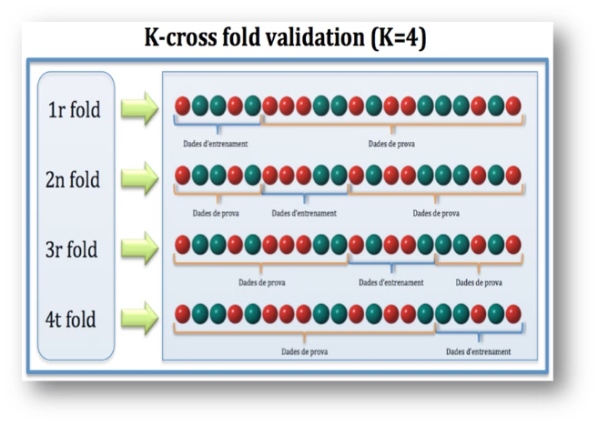
Implementation Algorithm
Cross-validation is a resampling technique for testing machine learning models on a small dataset.
The technique involves a single parameter, k, which determines the number of groups the data sample is divided into.
This method is commonly known as "k-fold cross-validation."
When a specific value for k is provided, it replaces k in the model's reference (e.g., k=4 for 4-fold cross-validation).
Cross Validation

Slide 21
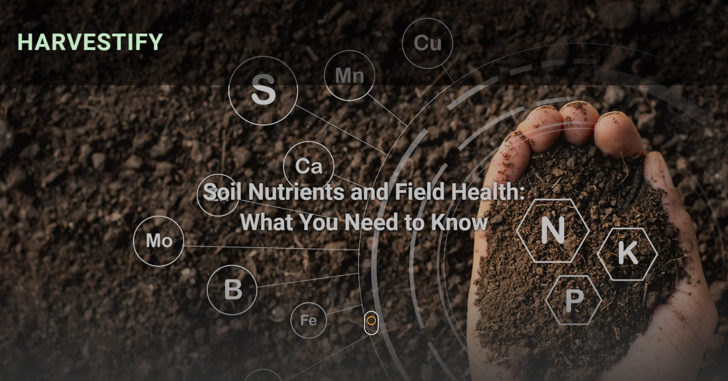
Results

Slide 22

Results

Slide 23

Results

Slide 24
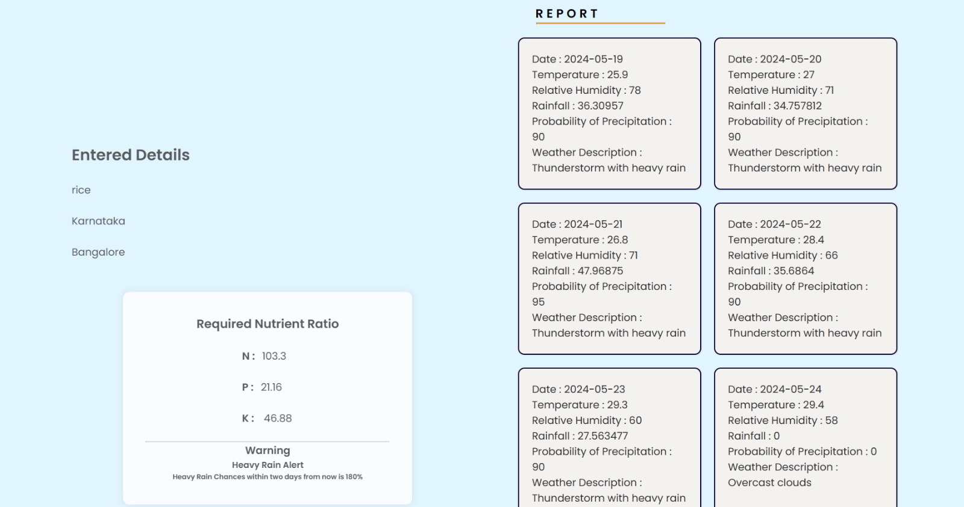
Results

Slide 25

Future Scope
Looking ahead, there are several avenues for enhancing and expanding the system. The project can be extended to include a wider variety of crops and incorporate advanced machine learning models for improved prediction accuracy. Integration with Internet of Things (IoT) devices, such as soil sensors and weather stations, can provide real-time, localized data, further refining recommendations.

Slide 26
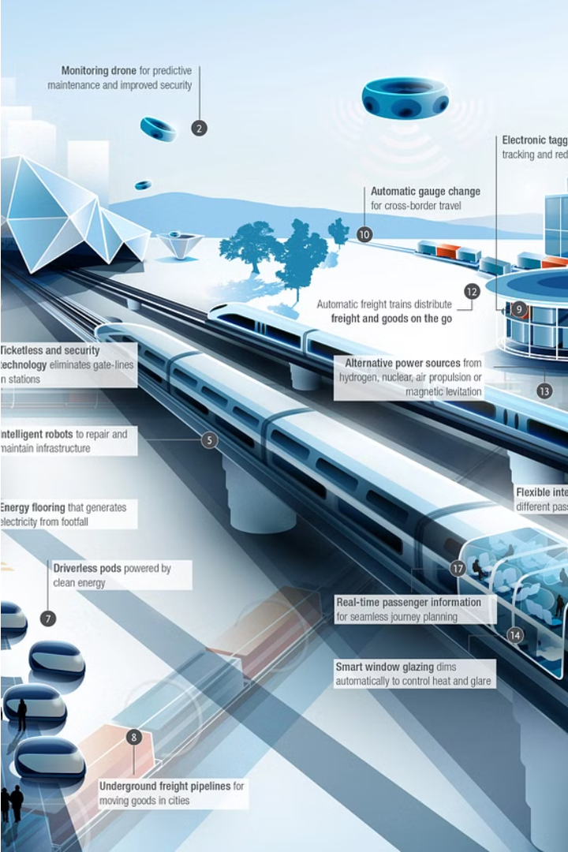
Future Scope
Developing a mobile application and adding support for multiple local languages will increase accessibility for farmers. Additionally, continuous integration of user feedback, collaboration with agricultural experts, and incorporation of economic analysis tools can refine the system to better meet farmers' practical needs. These enhancements will not only improve the system's effectiveness but also pave the way for more sustainable and productive farming practices.

Slide 27
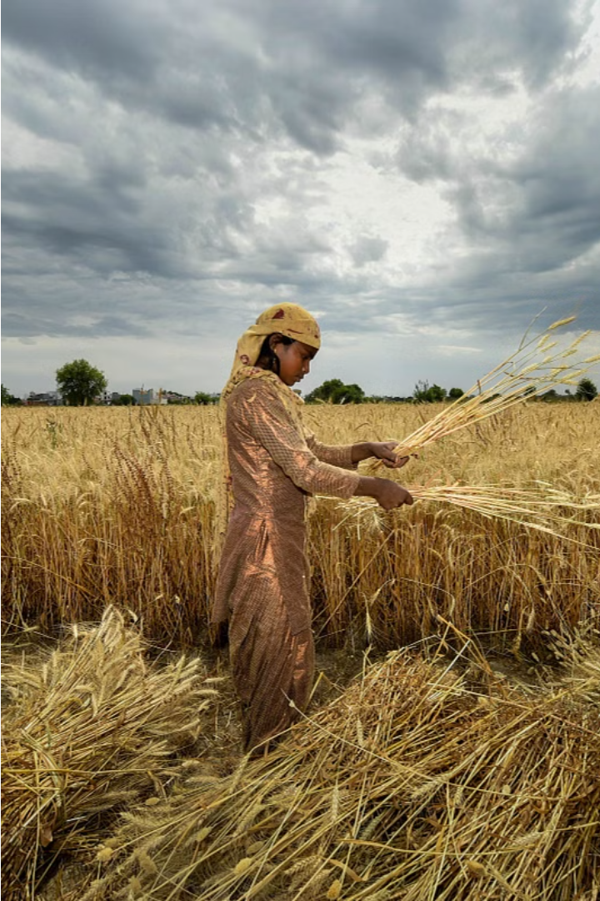
Conclusion
As we've seen, the Harvestify system has delivered impressive results, with significant improvements in crop yields across multiple crop types. Looking ahead, there are exciting opportunities to further enhance the system and expand its impact. We remain committed to driving sustainable and productive farming practices that empower farmers worldwide.

